Slide 1

Customer Churn Analysis using Machine Learning
&
Deep Learning
-Model Created by Abhisek De

Slide 2
Churn Risk Prediction
Objective
To identify high-risk churn customers by combining:
Historical churn behavior patterns (probability of churn)
Future churn magnitude prediction (how severe churn may be)
This hybrid approach ensures early warning + impact estimation, enabling targeted retention actions.
Step 2: Data Ingestion
What we did
Loaded monthly churn data (Mar’25 – Feb’25)
Converted churn history into a structured matrix
Why it matters
Establishes a clean, chronological view of churn behavior
Prepares data for machine learning consumption
Step 1: Technology & Framework Setup
Step 3: Data Normalization
What we did
Standardized churn values using z-score normalization
Why it matters
Prevents models from being biased by scale differences
Improves model stability and convergence
Business Value
More accurate and reliable predictions
What we did
Loaded Python libraries for:
Data processing (Pandas, NumPy)
Statistical modeling (Gaussian Mixture Model)
Deep learning (LSTM – Long Short-Term Memory)
Why it matters
Ensures a scalable, production-ready AI framework
Enables both pattern discovery and time-series forecasting

Slide 3
Reproducibility & Governance
Step 4: Churn Probability Estimation (EM / GMM Model)
What we did
Applied Gaussian Mixture Model (GMM) to segment customers into 4 churn behavior clusters (Lowest 25%- Stable or Low Churn, 25%-50%- Moderate Churn, 50%-75%- Rising Churn, Top 25%- High Risk Churn)
Identified the highest-risk cluster based on average churn level
Assigned each site a probability of belonging to this high-risk churn cluster
Why this is important
This gives us a true churn probability, not just a binary flag
Customers with similar churn patterns are grouped together
Outcome
A new metric: churn_probability = Likelihood of being a high-risk churn customer
Step 6: Model Performance Evaluation
Metrics Used
RMSE – Prediction error magnitude
MAE – Average absolute error
R² Score – Model reliability (explained variance)
Why this matters
Ensures predictions are:
Statistically sound
Business-usable
Provides confidence before deployment
Step 7: Future Churn Prediction
What we did
Applied the trained LSTM model to all sites
Predicted next-month churn volume
Outcome
New metric: predicted_next_churn
This represents expected churn impact per customer.
Step 5: Churn Magnitude Forecasting (LSTM Model)
What we did
Used LSTM neural networks to learn month-over-month churn trends
Trained the model to predict next-month churn magnitude
Why LSTM
LSTM is designed for time-series data
Captures:
Trend
Seasonality
Temporal dependencies
Business Meaning
Not just “Will churn happen?”
But “How big will the churn impact be?”
Score Range | Risk Level
Low | LOW
Medium | MEDIUM
High | HIGH

Slide 4
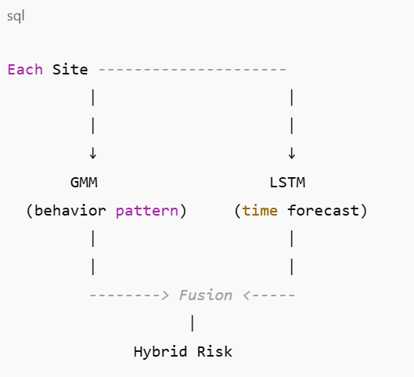
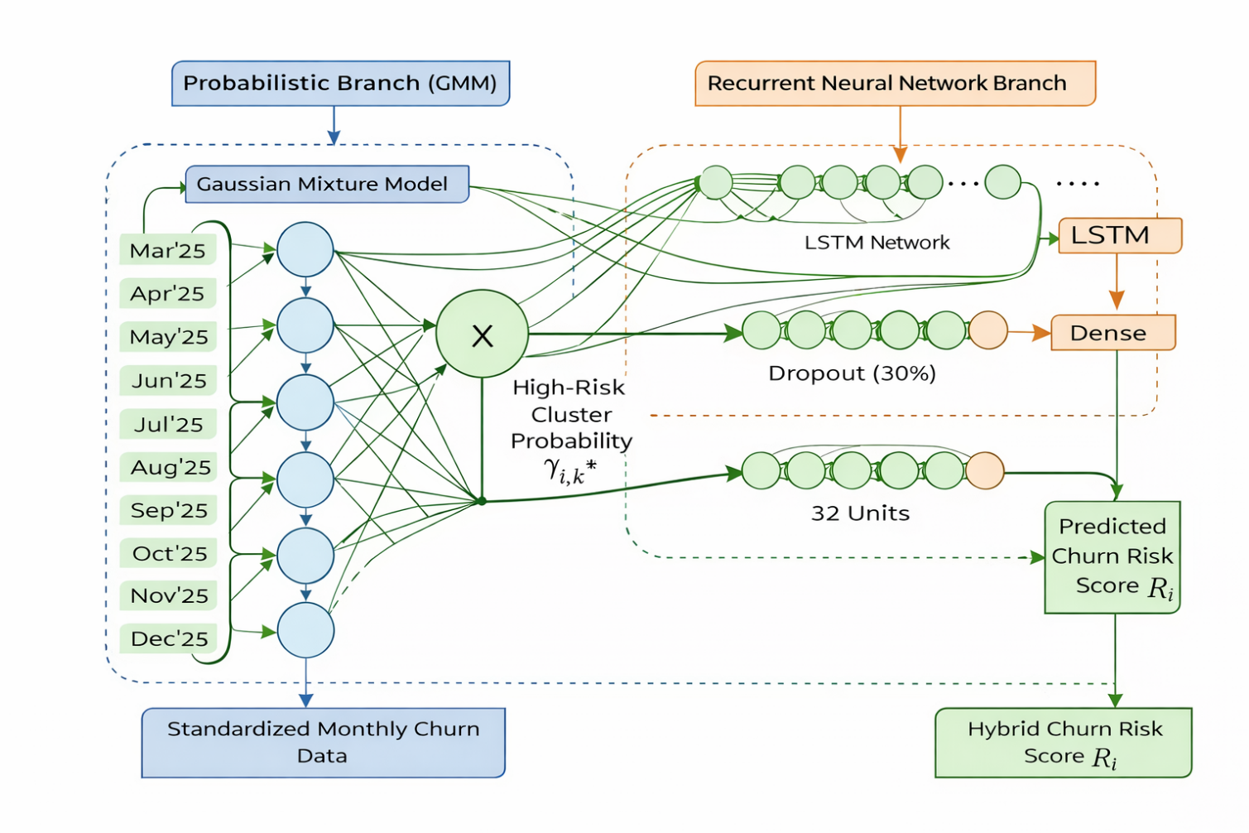
Output
Step 8: Model Transparency & Reporting
What we did
Printed all model efficiency metrics
Ensured full traceability of decisions
Why management should care
Transparent AI
No “black-box” behavior
Metrics ready for review
Sample Illustration
Step 9: Final Output Delivery
What we delivered
Excel file with:
Churn probability
Predicted future churn
Hybrid risk score
Risk classification
Step 10: Future Enhancement
Add traffic and KPI data
Predict 2 Month ahead
Integrate with Dashboard
Real Time AI automation

Slide 5
Thank You

